Slide 1
Lecture-34
Mathematics 2 (15B11MA211)
CO [C106.5]
Topic: Laurent’s Series Expansion
Reference for the lecture
R.K Jain and S.R.K. Iyenger, “Advanced Engineering Mathematics” fifth edition, Narosa publishing house, 2016.

Slide 2
Topics Covered
Laurent series
Properties
Examples

Slide 3
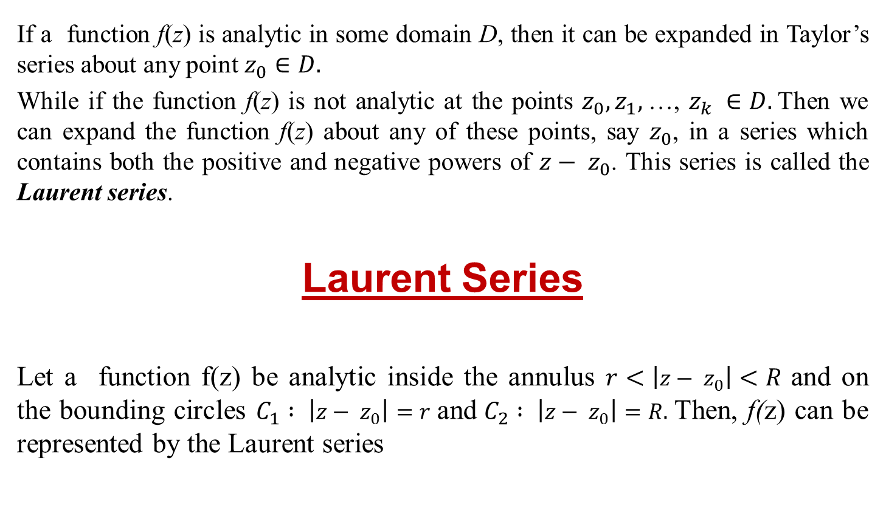


Slide 4
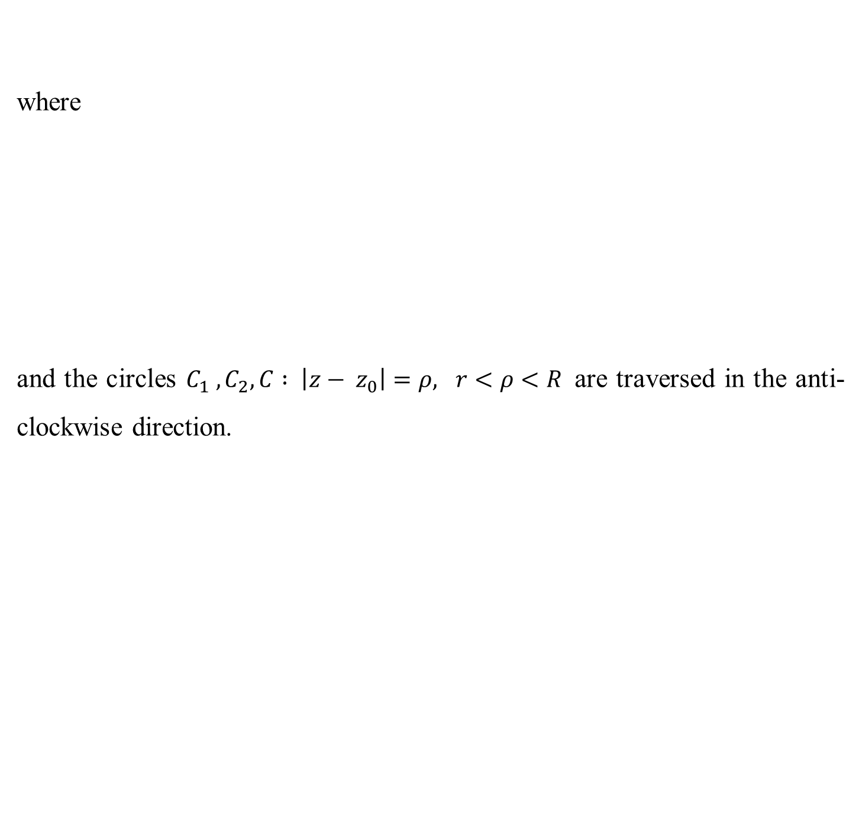
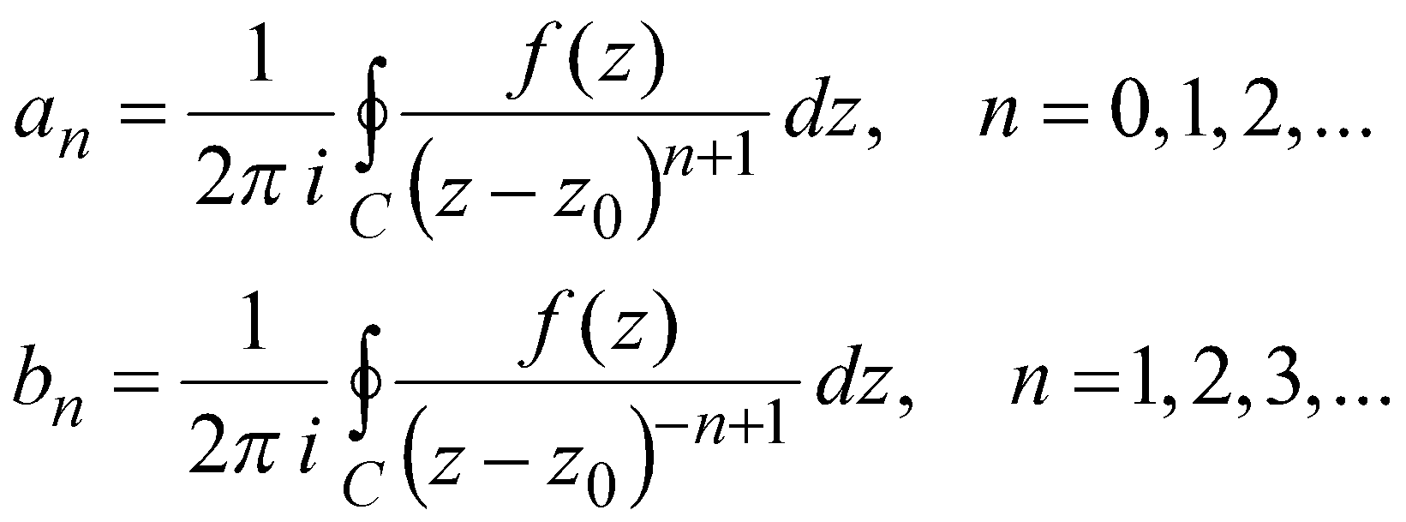
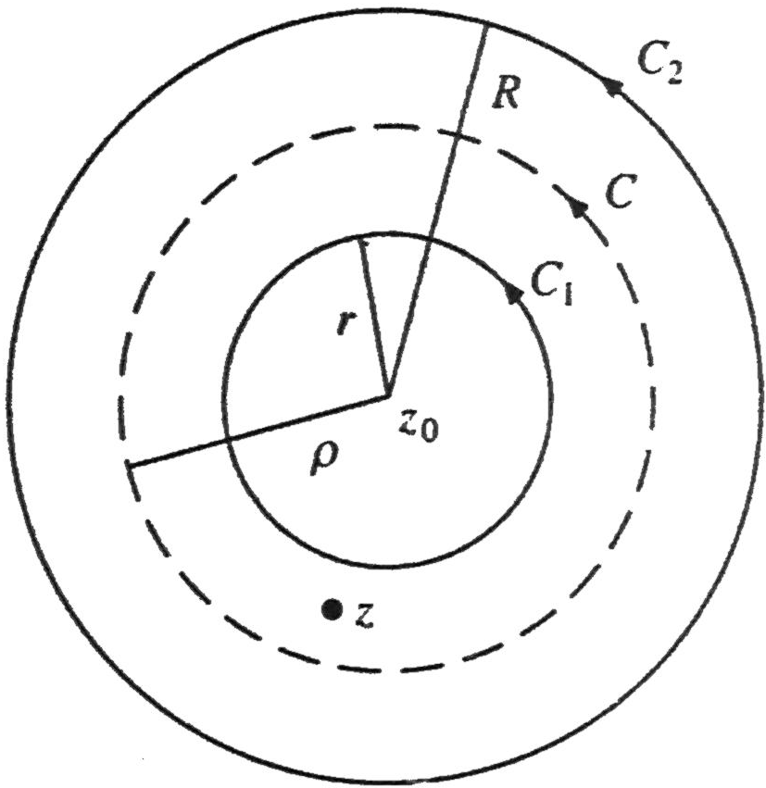

Slide 5

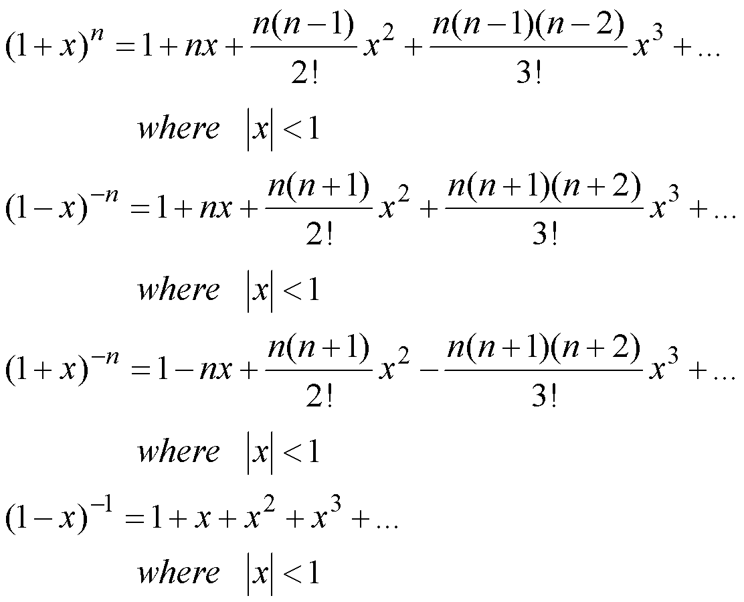

Slide 6
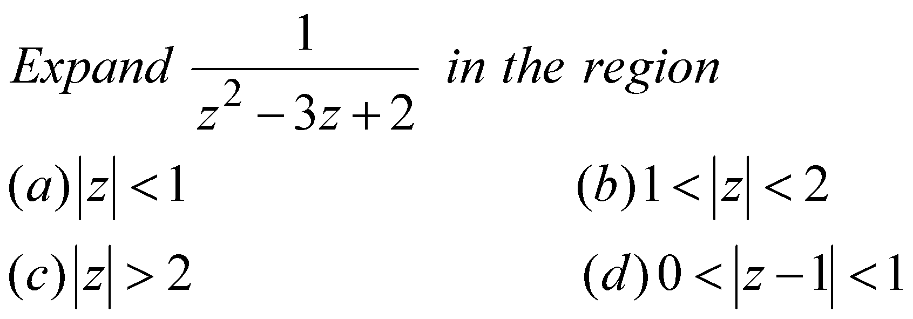
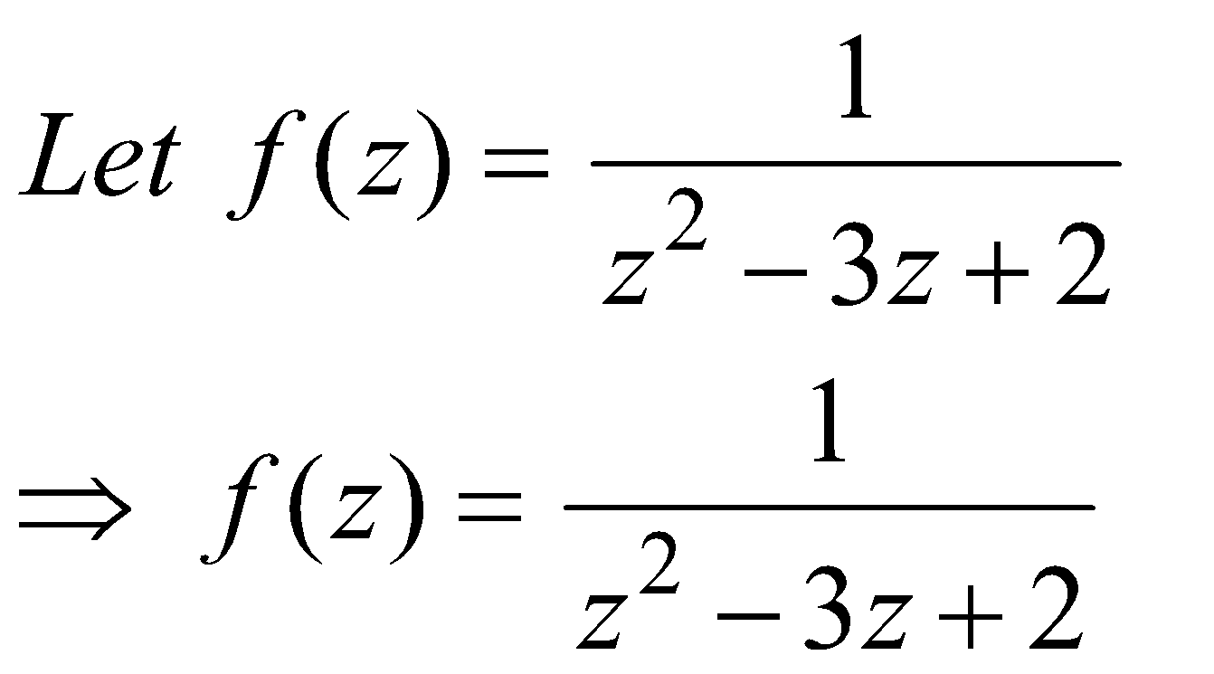
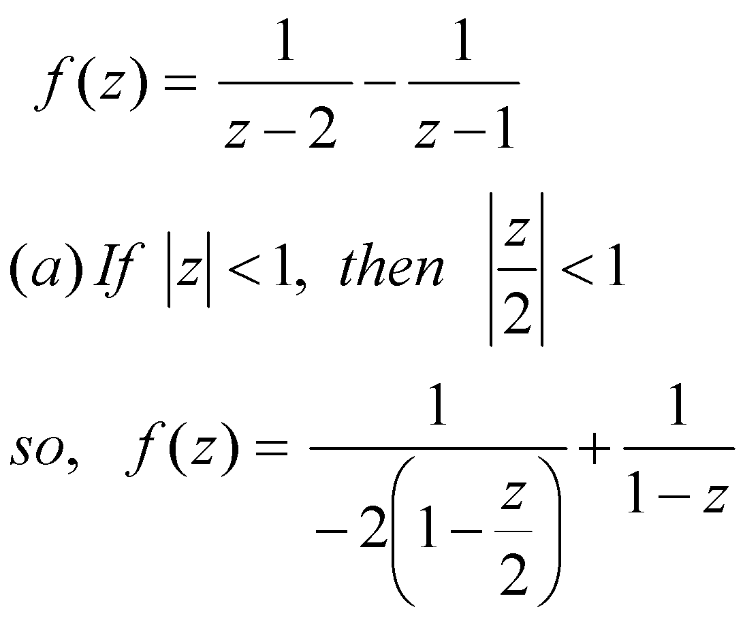
Example 1:
Sol:
Using partial fraction

Slide 7
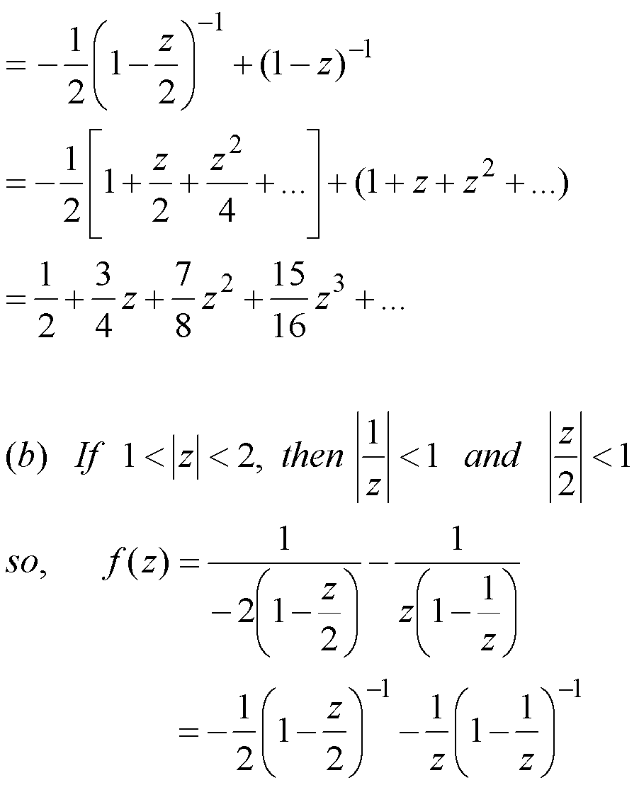

Slide 8
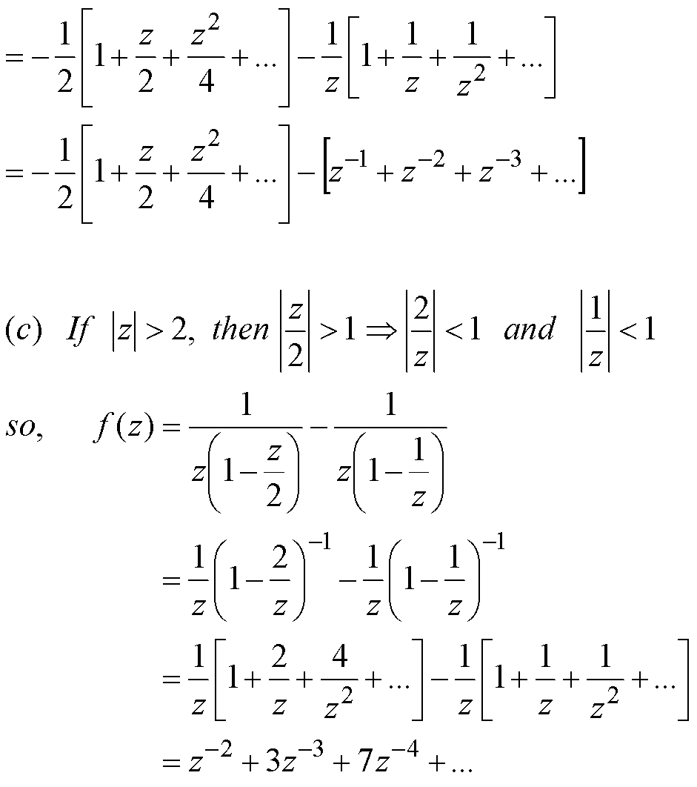

Slide 9
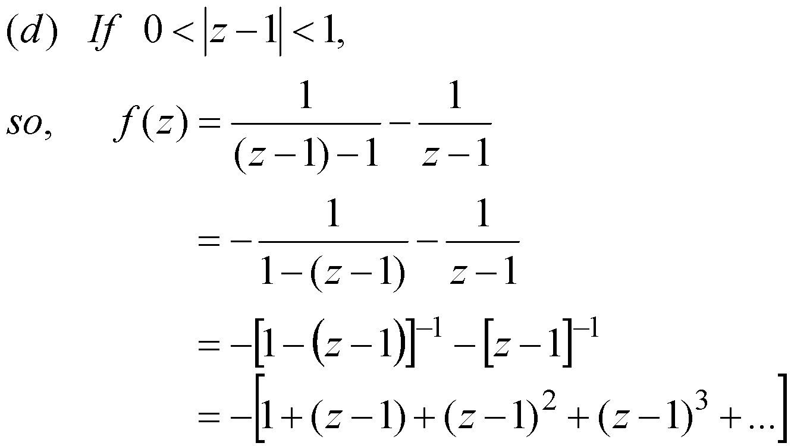

Slide 10

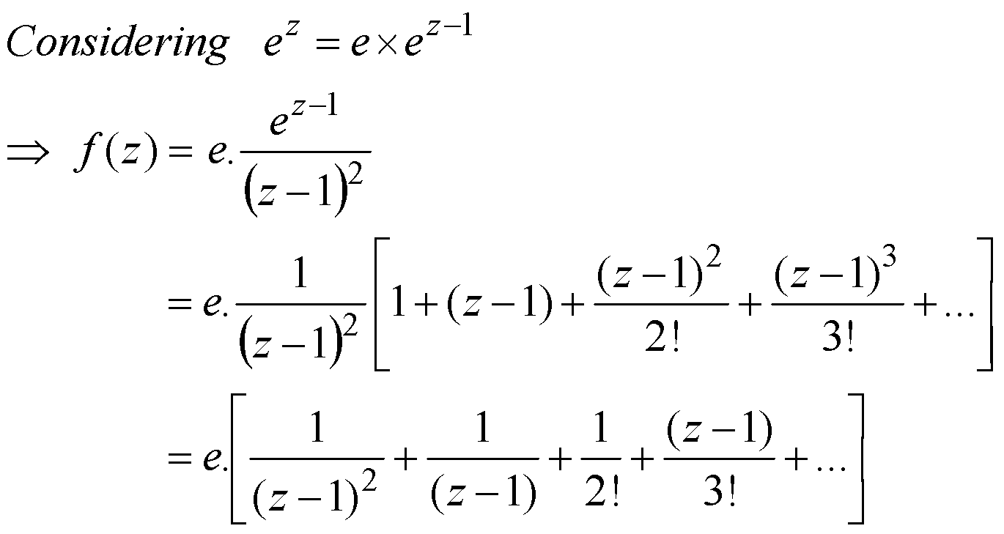
Example 2:
Sol:

Slide 11

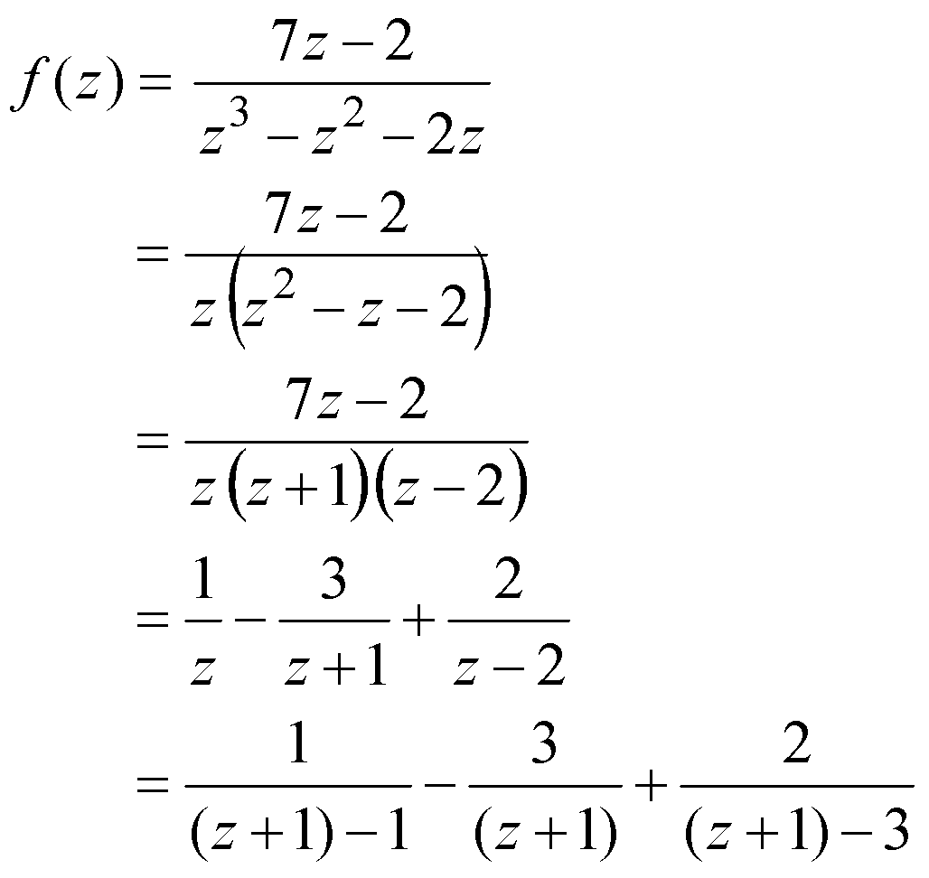
Example 3:
Sol:

Slide 12
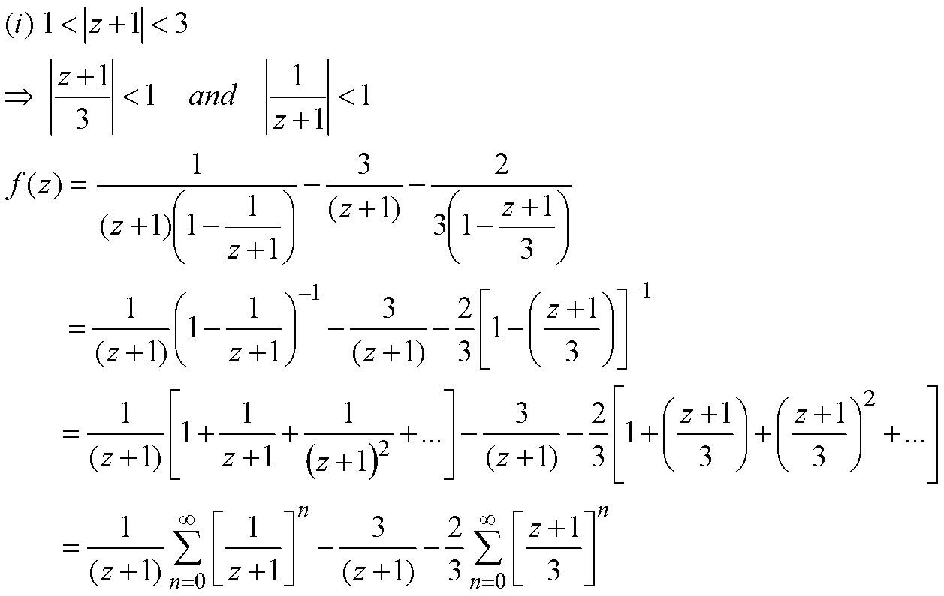

Slide 13
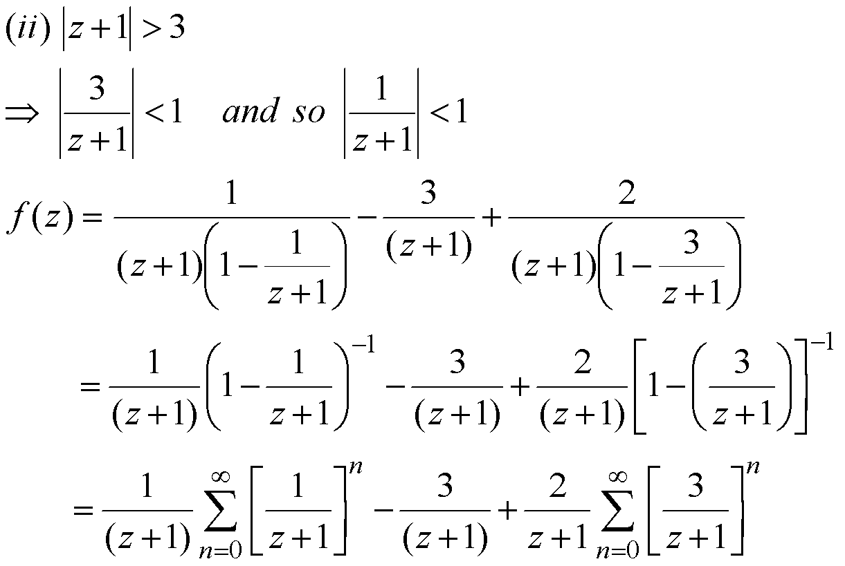

Slide 14
Thank You

